Slide 1
Literature Presentation - Colorectal Cancer
Rishee, Natalie, Sonia

Slide 2
Multi-omics Approach Reveals Distinct Differences in Left- and Right-Sided Colon Cancer
(genomics, transcriptomics, epigenomics)

Slide 3
Hypothesis
There is a difference in the underlying molecular features present in left-sided and right-sided colon cancer
embryologic origins
microenvironments
distinct blood supplies
patient demographic

Slide 4
Methodology
TCGA data portal
colon adenocarcinoma (COAD) somatic mutation data retrieval and processing
COAD level three DNA methylation data (HM450k) retrieval and processing
Gene expression data processing and normalization
Integrated analysis of miRNAs and mRNAs
Network construction
Immunohistochemistry staining
Notes:
Remove silent mutations & RNA mutations
Remove sample with over 10% missing data
Romove genes with an expression level lower than 1

Slide 5
Main Findings
Multiple FMGSs were identified in both LCC & RCC, and somatic mutation patterns were identified that co-occurred with certain genes linked to cancer
LCC & RCC had distinct driver patterns that should be considered in future targeted cancer therapy.
Hypermethylation occurred in RCC
Changes in DNA methylation status already thought to be involved in colorectal cancer initiation/development
Oncogenes were overexpressed & tumor-suppressor genes were repressed in RCC
Difference in non-coding RNAs between LCC & RCC
15 cancer-related miRNA differentially expressed LCC vs RCC
Pathway alteration differences observed between LCC & RCC linked to growth/migration of cancer cells
RCCs tend to be more aggressive through orchestrating invasive gene modules
Notes:
oncogenes/ts genes: mrnaseq data compiled in the tcga, deg = differentially expressed genes compared lcc vs rcc, unregulated/downregulated functional annotation - particularly prostate cancer susceptibility (PRAC) gene downregulated in RCC, along with HOXB13 (colorectal cancer suppressor), HOXC6 TF (highly expressed in cancer). Further analysis showed 13 downregulated genes possibly repressed by hypermethylation.
miRNA = microRNA, one in particular mir10b associated with cancer metastasis significantly higher expression in RCC, multiple others ex mir466 downregulated but predicted target transcriptional repressor contributing to cancer progression upregulated
Huge difference in expression lcc vs rcc, but most of regulatory network shared. Unlike tf, mirna has restricted role/not key in COAD (colon adenocarcinoma); other modules linked with cell-cycle

Slide 6
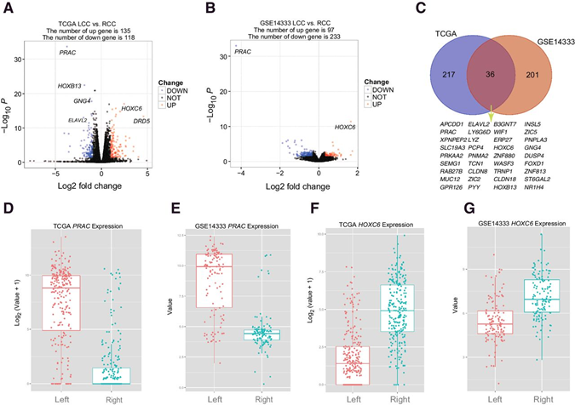
Figure 1
A/B - Volcano plots showing overexpressed & underexpressed genes in RCC from 2 different data sets
C - Venn diagram for DEGs between the 2 data sets
D-G - boxplot distributions of PRAC & HOXC6 expression level
Notes:
Data from GSE14333 publicly available data and TCGA
Supports oncogene/tumor suppressor under/overexpression as previously mentioned
Authors likely chose to represent a variety of distributions of expression and concentration in which they occurred for which box/volcano works best

Slide 7
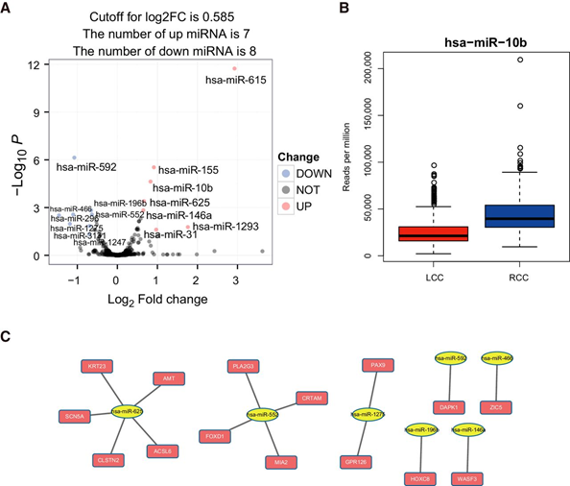
Figure 2
A - Volcano plot showing 11 miRNAs overexpressed, 5 miRNAs underexpressed (TCGA data)
B - Box plot showing miR-10b expression level is higher in RCC than LCC
C - Integrated analysis using nodes showing some DEGs regulated by miRNA
Notes:
Yellow elliptical nodes represent miRNAs, and magenta rectangle nodes represent miRNA targets.

Slide 8
Diagnosis and Treatment of Metastatic Colorectal Cancer
(genomic)

Slide 9
Goals
Find new treatment strategies that use pathologic and molecular tumor testing to select therapy have the potential to improve prognosis of metastatic CRC
20% patients have metastatic CRC; 25% patients develop metastases
5 year survival rate less than 20%

Slide 10
Methods
PubMed and Cochrane databases: randomized clinical trials (RCTs), meta-analyses, and systematic reviews
US Food and Drug Administration (FDA) documents in the public domain: drugs in treatments
Evaluated 222 phase 3 RCTs, 111 meta-analyses, 97 systematic reviews, and 4 practice guidelines
Compared the treatments and their respective results

Slide 11
Conclusion
Necessary improvements on molecular/genomic profiling
Used for more targeted therapies
Treat specific biological features of tumors
Greater benefit and less toxicity of treatment

Slide 12
Questions
Some median survival rates are only improved by 2 to 4 months while others are extended by over 30 months. Is this a result of certain types of tumors being more aggressive, or are some target treatments simply less effective?
Combining the findings of the research and review paper, should patients with RCC receive different treatments than those with LCC? Should the RCC treatments be more aggressive?

